Slide 1
Practice exam

Slide 2
This is a practice exam covering part of the topics:
modeling, visualization in R and
basic skills in python.
The final exam includes all topics: make, docker, ...

Slide 3
Some tips)
1. Make your Rstudio clean by doing `rm(list = ls())` or
by opening a new project.
2. Try to knit your Rmd in the middle, not once at the last minute.

Slide 4
Part I R
15 minutes
modeling, visualization

Slide 5
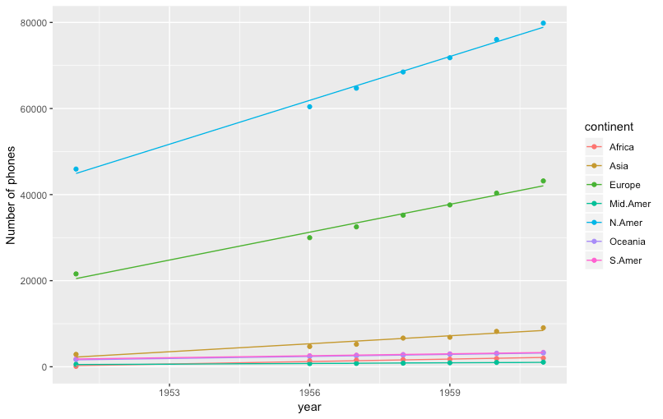
reproduce the following graph using `WorldPhones` data in R.
(Each continent has a linear fitted line.)
Notes:
#Creating long-form data set so that we can do ggplot
WorldPhones%>%
data.frame()%>%
add_rownames(“year”)%>%
mutate(year=as.integer(year)%>%
gather(key=“continent”, value=“phones”, -year) -> dat
phone_lm<-lm(phones~year*continent,dat) #You can also use geom_smooth with method = “lm”
#Can also use geom_abline with slopes and intercepts of phone_lm
dat%>%add_predictions(phone_lm)%>%
ggplot(aes(year,phones,col=continents)+
geom_point()+
geom_line(aes(year,pred,col=continent)

Slide 6
2. Clustering and visualization
Use `attitude` data to do K-means clustering.
(K is the smallest integer that gives tot.withinss < 12,000,
where tot.withinss is the within-cluster sum of squares.)
Draw a scatter plot using x = learning, y = complains, and col = cluster.
Using the previous part (b), draw a scatter plot, also having the centers of clusters (centers should have black points with size=3).
Notes:
#Simpler way to do for loop
set.seed(1)
map_dbl(1:10, ~kmeans(attitude, .)$tot.withinss)
min(which(map_dbl(1:10,~kmeans(attitude,.)$tot.withinss)<12000)) -> k

Slide 7
Part II
15 minutes
python

Slide 8
Write a python function called “prefix_str” that takes in a string and a number x and return the first x letters of that string.
Eg. prefix_str(“abcde”, 2) should return “ab”
2. Write a function called “col_constraint” that takes in a pandas dataframe, a column name, and a number n. This function should output the rows with values of that column less than n.
Eg. col_constraint(df, “BMI”, 20) should return the rows of df with BMI less than 20
3. Write a python function called “list_delete” that takes in a list and a number i and output the list without the ith element of that list
Eg. list_delete([1,2,3,4,5], 2) should return [1,3,4,5]
Notes:
Try to do this without using “native” python functions

